Slide 1
Migrant labour in petro-capitalism
Union interactions with foreign workers in Saskatchewan
Andrew Stevens, PhD
Associate Professor
Faculty of Business administration
University of Regina

Slide 2
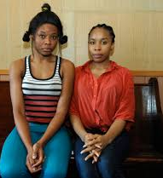
Migrant worker solidarity

Slide 3
Assessing union-member attitudes & interaction
Mixed methods: survey & semi-structured interviews
Survey (Union members n= 130)
46 branching questions (citizenship, demographics, years in Canada, industry, occupation, job satisfaction, working conditions, union engagement)
10 Public & private sector unions
Union attitudes: McShane’s 7-point Likert scale
Interviews (n = 55)
Status, reasons for migration, time in Canada, experience with recruiters and agencies, working conditions, aspirations, discrimination, experience with unions, education,

Slide 4
Migrant workers in Saskatchewan

Slide 5
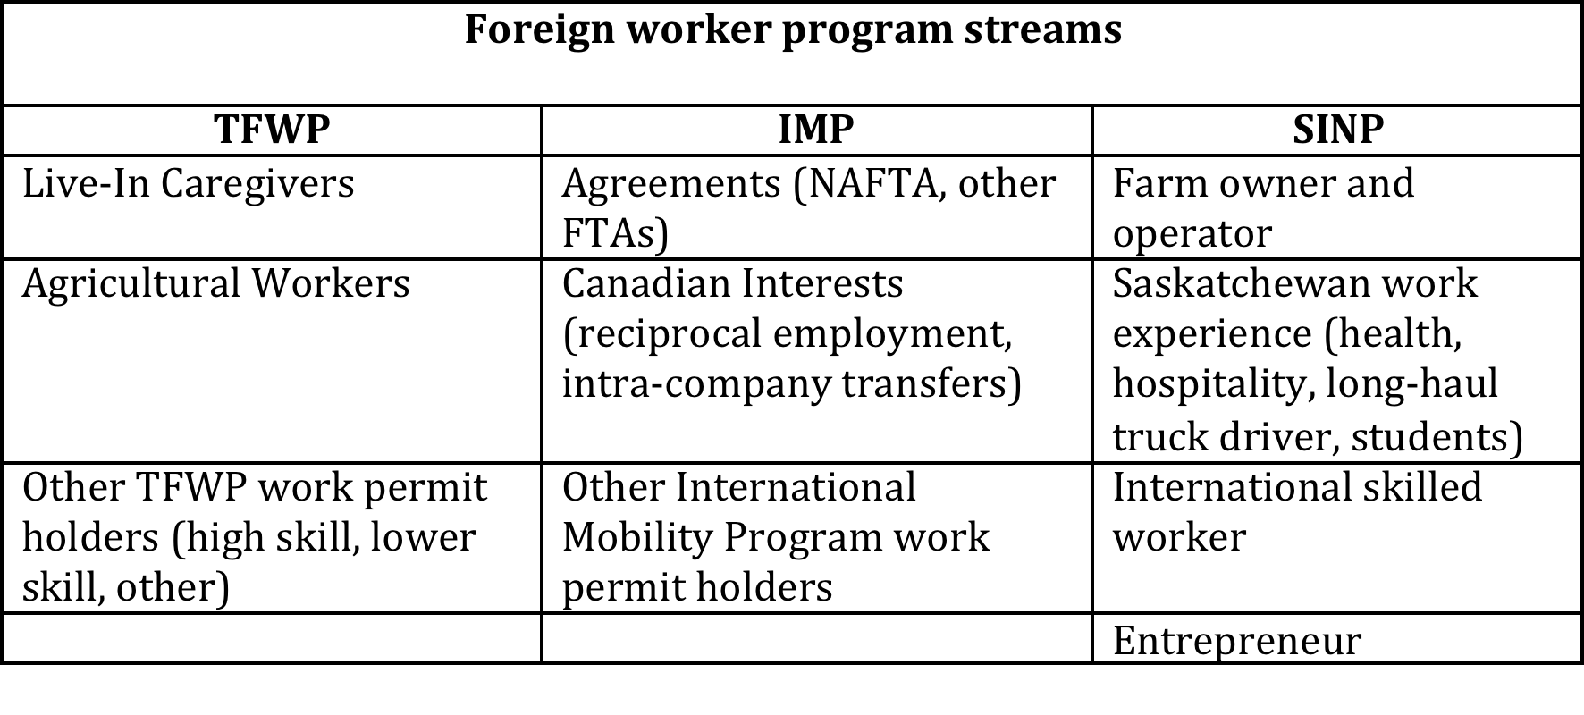
Saskatchewan’s foreign worker regime

Slide 6
“Petro-capitalism” & the “New Saskatchewan”
Neoliberalism and the political pendulum swings
The rentier state: “Petro-capitalism” & “prairie capitalism”
Varieties: Norway, Canada, and the Middle East
Oil and the construction of a global migrant labour force
Dual labour market hypothesis (Piore, 1979; Burawoy 1976)
Saskatchewan population trends & the role of migrant labour

Slide 7
Saskatchewan context
Saskatchewan “needs skilled workers in the fields of biotechnology, telecommunications and manufacturing. We need healthcare professionals, business people and farm owners and operators” (Then-Minister of Intergovernmental and Aboriginal Affairs, Eldon Lautermilch, 2003).
Saskatchewan-federal government agreement in 1998 (SINP)
Bi-national agreement signed with the Philippines in 2006
Part of Saskatchewan’s immigration and labour market policy (1998-2009)
Exploitation and the Foreign Worker Recruitment and Immigrant Services Act (FWRISA) in 2013

Slide 9
Foreign workers across industries
Industry | Foreign workers | Foreign workers as % of industry workforce | Immigrants | Immigrants as % of industry workforce
All industries | 7,065 | 1.30% | 65,945 | 12.12%
Food services and accommodations | 2,060 | 5.89% | 10,220 | 29.20%
Retail | 960 | 1.60% | 8,600 | 14.32%
Education | 440 | 1.00% | 3,895 | 8.86%
Construction | 440 | 1.01% | 3,430 | 7.89%
Health care | 410 | 0.58% | 10,735 | 15.24%
Farms | 345 | 0.71% | 1955 | 4.07%
Taxi & limousine | 15 | 1.38% | 590 | 54.38%
Manufacturing | 295 | 1.18% | 5,260 | 14.32%

Slide 10
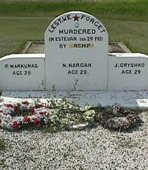
Unions and foreign labour
Settler colonialism and migrant labour
Saskatchewan history: Racism and exclusion reproduced in the labour movement
Crossing the fault lines of race & union renewal
Foster, Taylor, Khan (2015) typology of union responses:
Resistive (Building trades)
Facilitative
Active (UFCW)

Slide 11
Principal findings
Dynamic and diverse, but positive attitudes prevail
Frustration with labour’s incapacity to secure meaningful gains at the bargaining table
Belief in the core principles of equality and workplace rights
Address precarious workers
“Varieties of capitalism” and labour market regulation
Critical of market distorting effects of unions
Inter-worker tensions: benefits, leave provisions, skills/credentials
Appeal of “social unionism” and membership mobilization

Slide 12
Union attitudes (1= strongly agree; 7 strongly disagree)
 | M | SD
Unions are a positive force in Canada
Non-Canadian | 2.21 | 1.242
Canadian | 1.94 | 1.085
Workers are better off when they are part of a union
Non-Canadian | 2.19 | 1.299
Canadian | 2.01 | 1.145
If I had to choose, I probably would not be a member of a union
Non-Canadian | 4.88 | 1.896
Canadian | 5.33 | 1.695
Workers would be better off if there were no unions in Canada
Non-Canadian | 4.98 | 1.809
Canadian | 5.86 | 1.448
My union effectively represents the interests of its members
Non-Canadian | 2.69 | 1.261
Canadian | 2.59 | 1.232

Slide 13
Perspectives on foreign workers (1= strongly agree; 7 strongly disagree)
 | M | SD
Foreign workers are necessary in Saskatchewan
Non-Canadian (n = 52) | 1.77 | 1.041
Canadian (n = 78) | 3.44 | 1.877
Foreign worker lower wages for all Canadians
Non-Canadian | 5.02 | 1.59
Canadian | 3.79 | 1.761
Foreign workers are active in their union
Non-Canadian | 3.62 | 1.598
Canadian | 4.29 | 1.538
Foreign workers add important diversity to my workplace
Non-Canadian | 1.88 | 1.247
Canadian | 3.06 | 1.875
Employers should focus on employing Aboriginal workers over foreign workers
Non-Canadian | 4.13 | 1.669
Canadian | 3.76 | 1.745
Foreign workers are taking Canadian jobs
Non-Canadian | 5.08 | 1.713
Canadian | 3.74 | 1.819
Foreign workers add important diversity to my community
Non-Canadian | 1.71 | 1.035
Canadian | 2.91 | 1.881

Slide 14
My union could do more to: (1= strongly agree; 7 strongly disagree)
 | M | SD
Support me and other workers in the workplace
Non-Canadian | 2.13 | 1.205
Canadian | 2.71 | 1.27
Support workers who want to get involved with the union
Non-Canadian | 2.25 | 1.153
Canadian | 2.6 | 1.371
Support foreign workers
Non-Canadian | 2.23 | 1.323
Canadian | 2.81 | 1.349
Improve community engagement
Non-Canadian | 2.14 | 1.149
Canadian | 3.04 | 1.232
Support political engagement
Non-Canadian | 2.41 | 1.329
Canadian | 3.36 | 1.358
Support Aboriginal workers
Non-Canadian | 2.29 | 1.331
Canadian | 3.37 | 1.478
Support foreign workers
Non-Canadian | 1.94 | 1.047
Canadian | 3.64 | 1.667

Slide 15
Better shop-floor engagement
“You don’t feel comfortable to talk to [the union representative]… because they never made themselves present.” (Canadian citizen who first arrived as a refugee, mechanic)
Organizing and mobilization
“Leadership -- the top elected positions in healthcare -- are like 99% old white people…. [It] depends on the leadership how receptive they are to something like this. There is resistance from some quarters.” (Union organizer)

Slide 16
Addressing foreign worker needs
“I am an international student too. I know that they will look at you at an asset at the workplace, they don’t look at you in the long term. They don’t look at you in the perspective of a student, sorry international student.” (International student, employed part-time as a cook)
Efficacy
“I think that […] they’re not good at it cause we barely have [a wage] increase like maybe 25 cents every year. So they’re not good at it. (Permanent resident, works in meat packing industry)
“Yes, the union fairly represent me well. […] The union is fairly responsible… I believe the union can get closer more to employees, than what they are currently doing.” (Permanent resident, employed full-time with the provincial government)

Slide 17
Varieties of labour relations
“So I when I was working for [a major multinational corporation] in Germany, it was a unionized company there, but it’s, I was, I was amazed that it was not unionized in Canada … here the unions don’t have that many rights to, to tell the, the employers what to do.” (Permanent resident, photocopier technician)
Unions assumed to be resistive
They know as well as everybody else that we are against the Temporary Foreign Worker Program and I think in certain cases with some of these workers I’ve talked to a little bit on the work site, they feel like we’re against them.” (Alex Hanson, President of USW Local 9346)

